Slide 1

COVID-19 vs pneumonia deep learning model
Machine Learning Final Project
George Karcevski

Slide 2
Agenda
What is the problem?
What is the data?
Neural Network and Code
Results

Slide 3
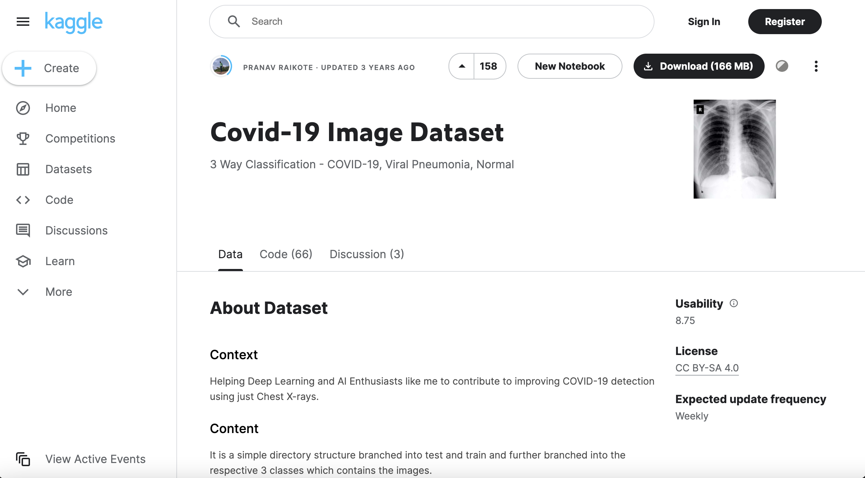
The problem
https://www.kaggle.com/datasets/pranavraikokte/covid19-image-dataset
Can we take X-Ray images and classify them as:
COVID-19
Pneumonia
No Illness

Slide 4
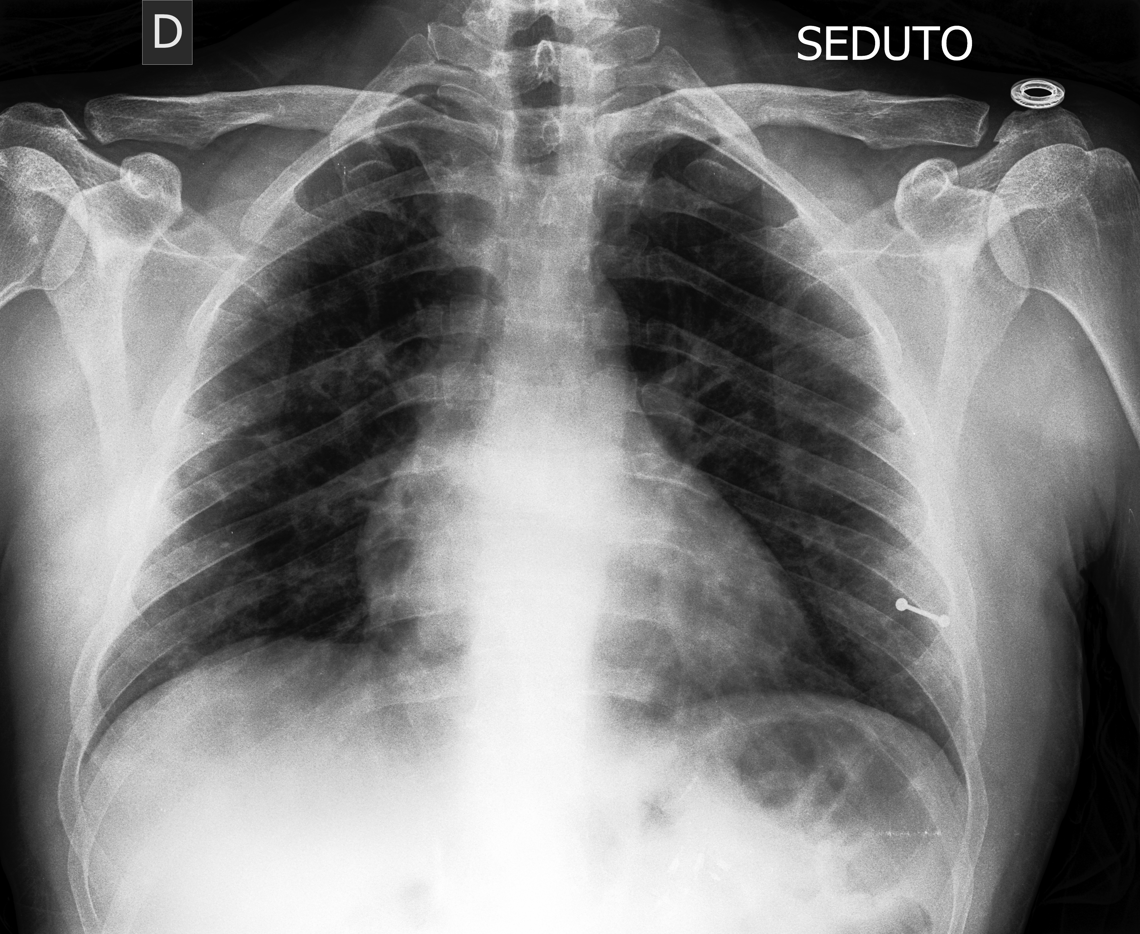
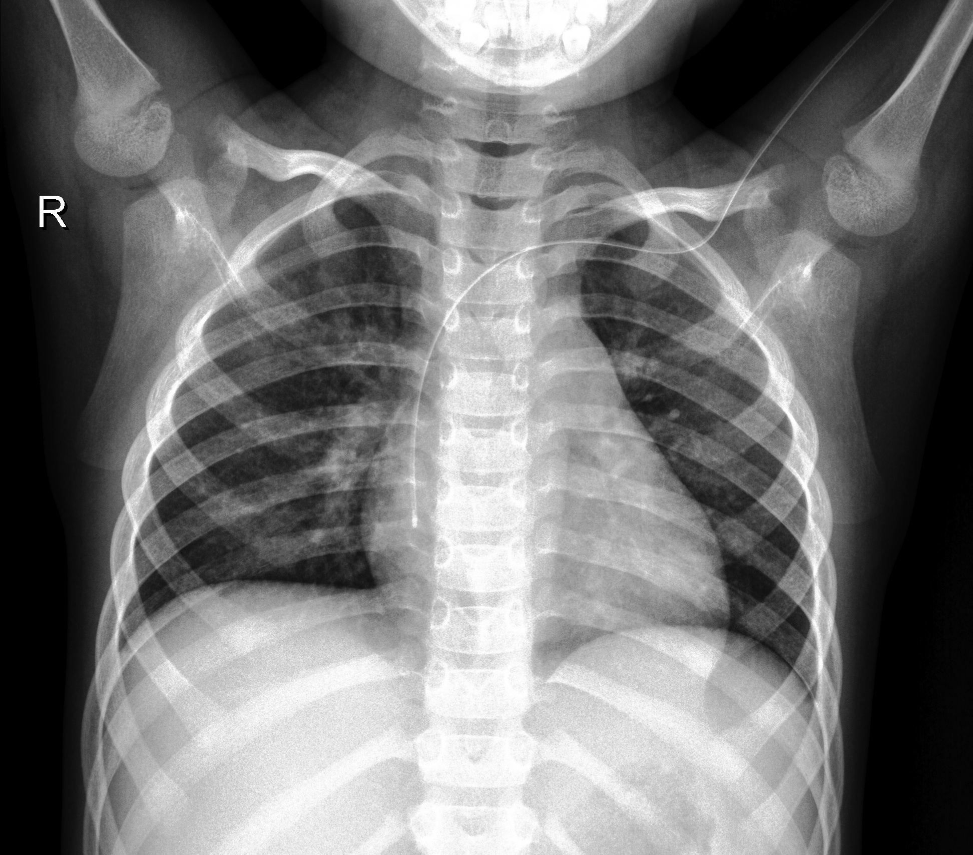
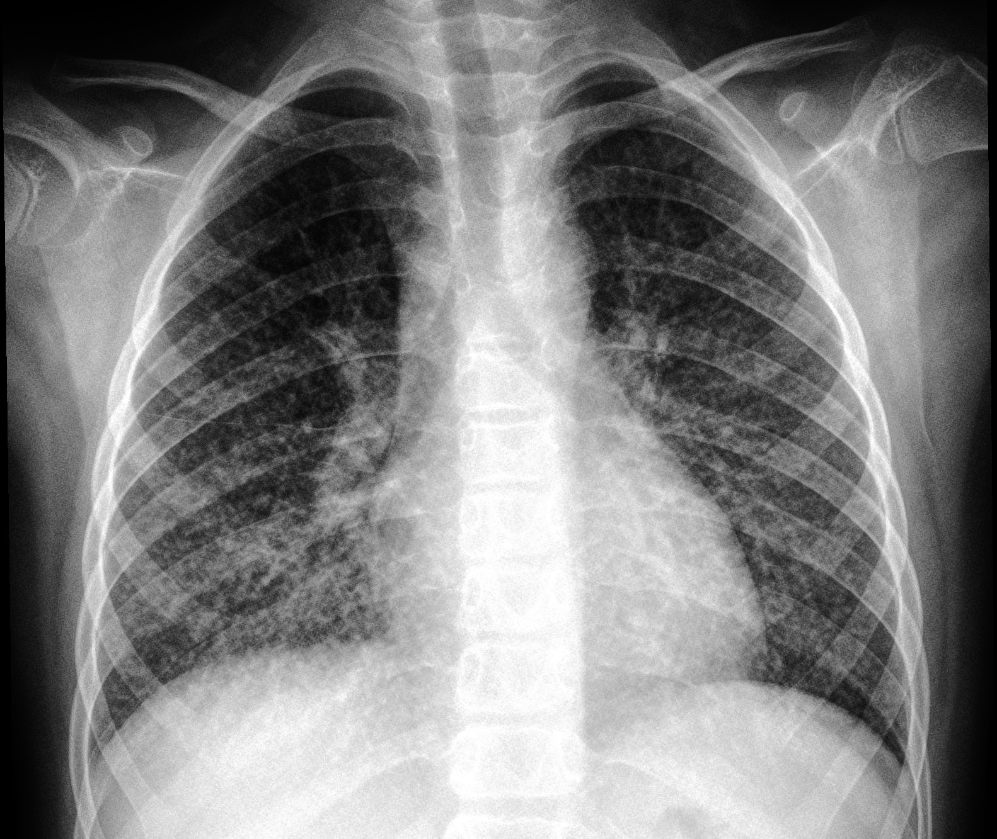
The data
COVID-19 X-Ray
Training Set – 251 Images
COVID -19– 111 images
Pneumonia – 70 images
No Illness –70 images
Test Set – 66 Images
COVID – 26 images
Pneumonia – 20 images
No Illness – 20 images
Normal X-Ray
Pneumonia X-Ray

Slide 5
Code - Building the Neural Networks
Preprocessing and Infrastructure
Simple Convolutional Neural Network
Complex Convolutional Neural Network
Pre-Trained Neural Network
Resnet50
Model Tuning through Data Augmentation

Slide 6
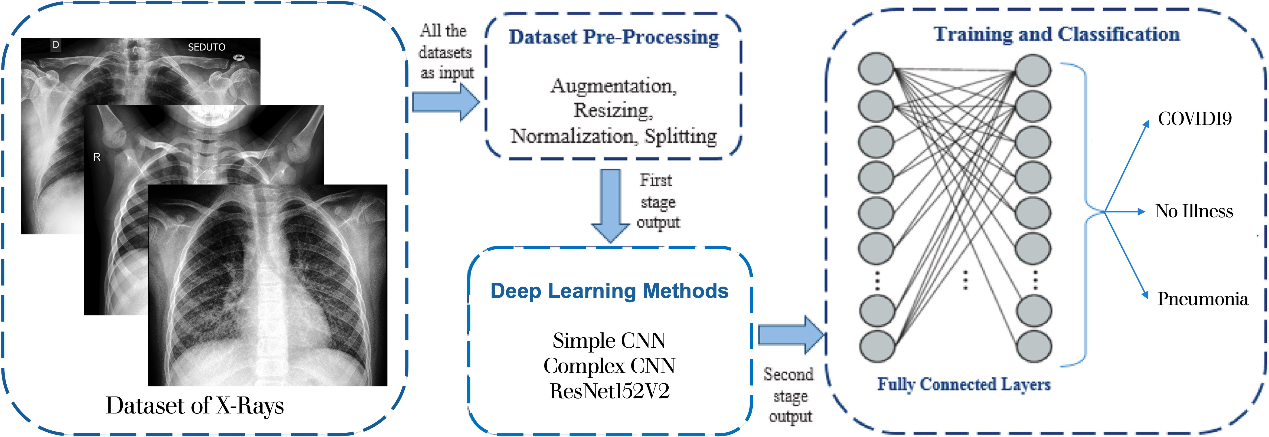
Deep Learning Preprocessing and Infrastructure
ResNet50

Slide 7
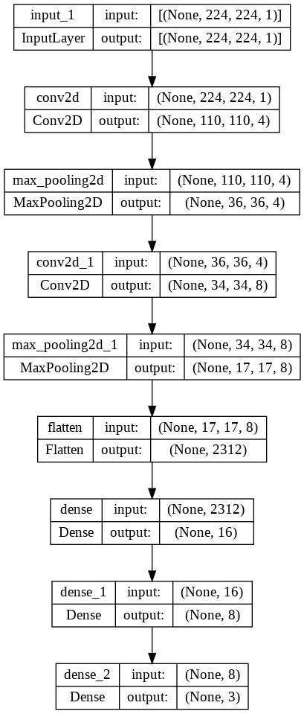
Simple Neural Network – 2 Layers Total Parameters = 37,000
Input Layer (Image Size) - (224,224)
Convolution Layer Conv1:
Conv1-1: 4 filters and Max Pooling
Convolution Layer Conv2:
Conv2-1: 8 filters and Max Pooling
Dense:
Dense1 : 16 nodes
Dense2: 8 Nodes
Dense 3: Softmax activation function
Output Layer
= **Filters and Nodes
= **Conv2D Layer

Slide 8
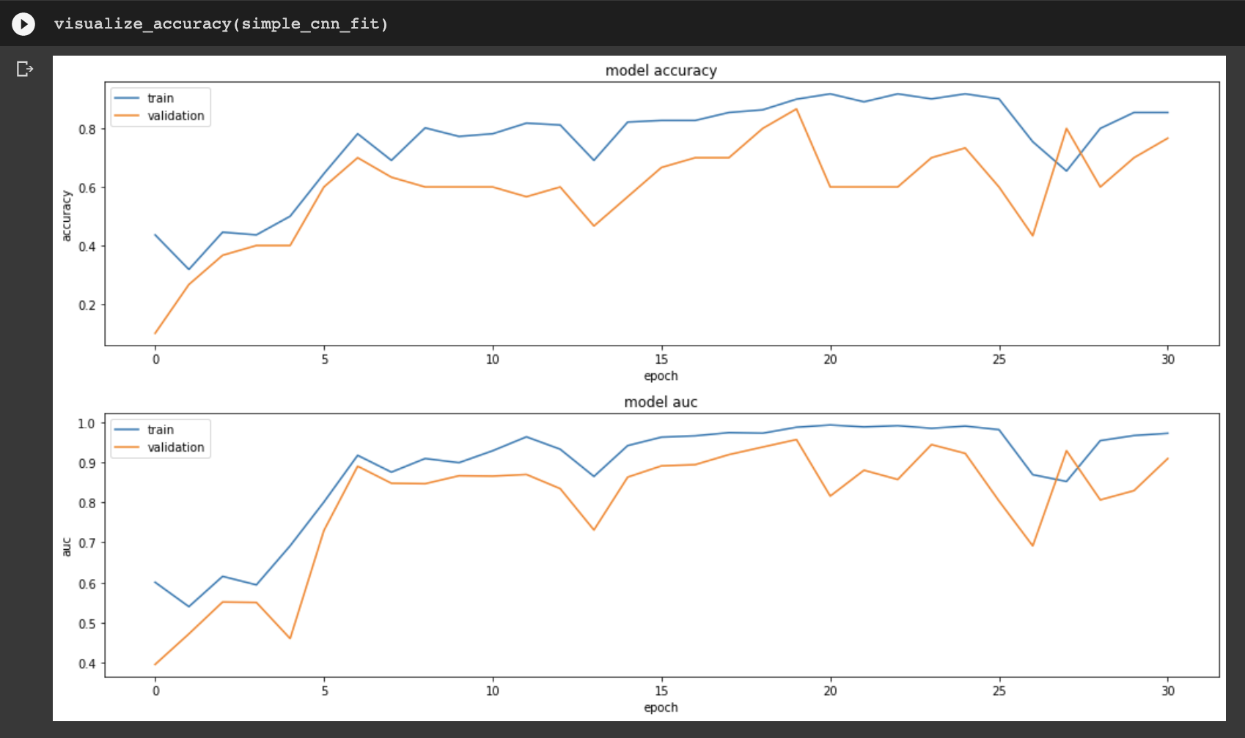
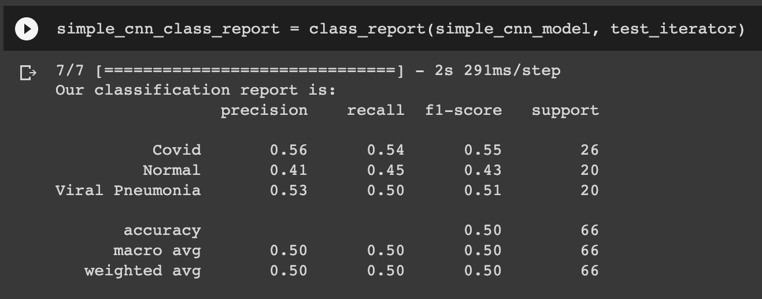
Simple CNN Results

Slide 9
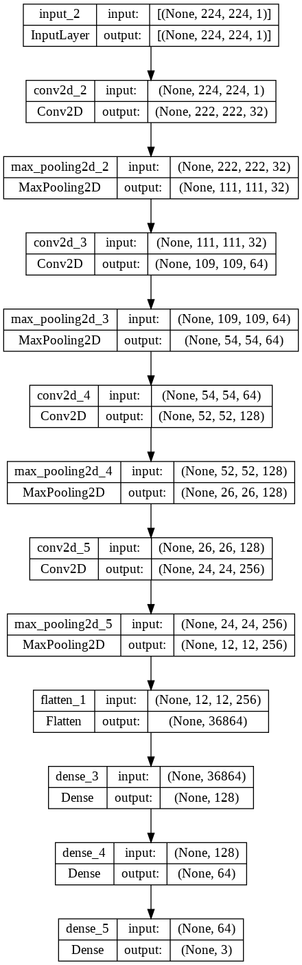
Complex Neural Network – 4 Layers Total Parameters = 5,200,000
Input Layer (Image Size) - (224,224)
Convolution Layer Conv1:
Conv1-1: 32 filters and Max Pooling
Convolution Layer Conv2:
Conv2-1: 64 filters and Max Pooling
Convolution Layer Conv2:
Conv2-1: 128 filters and Max Pooling
Convolution Layer Conv2:
Conv2-1: 256 filters and Max Pooling
Dense:
Dense1 : 128 nodes
Dense2: 64 Nodes
Dense 3: Softmax activation function
Output Layer
= **Filters and Nodes
= **Conv2D Layer

Slide 10
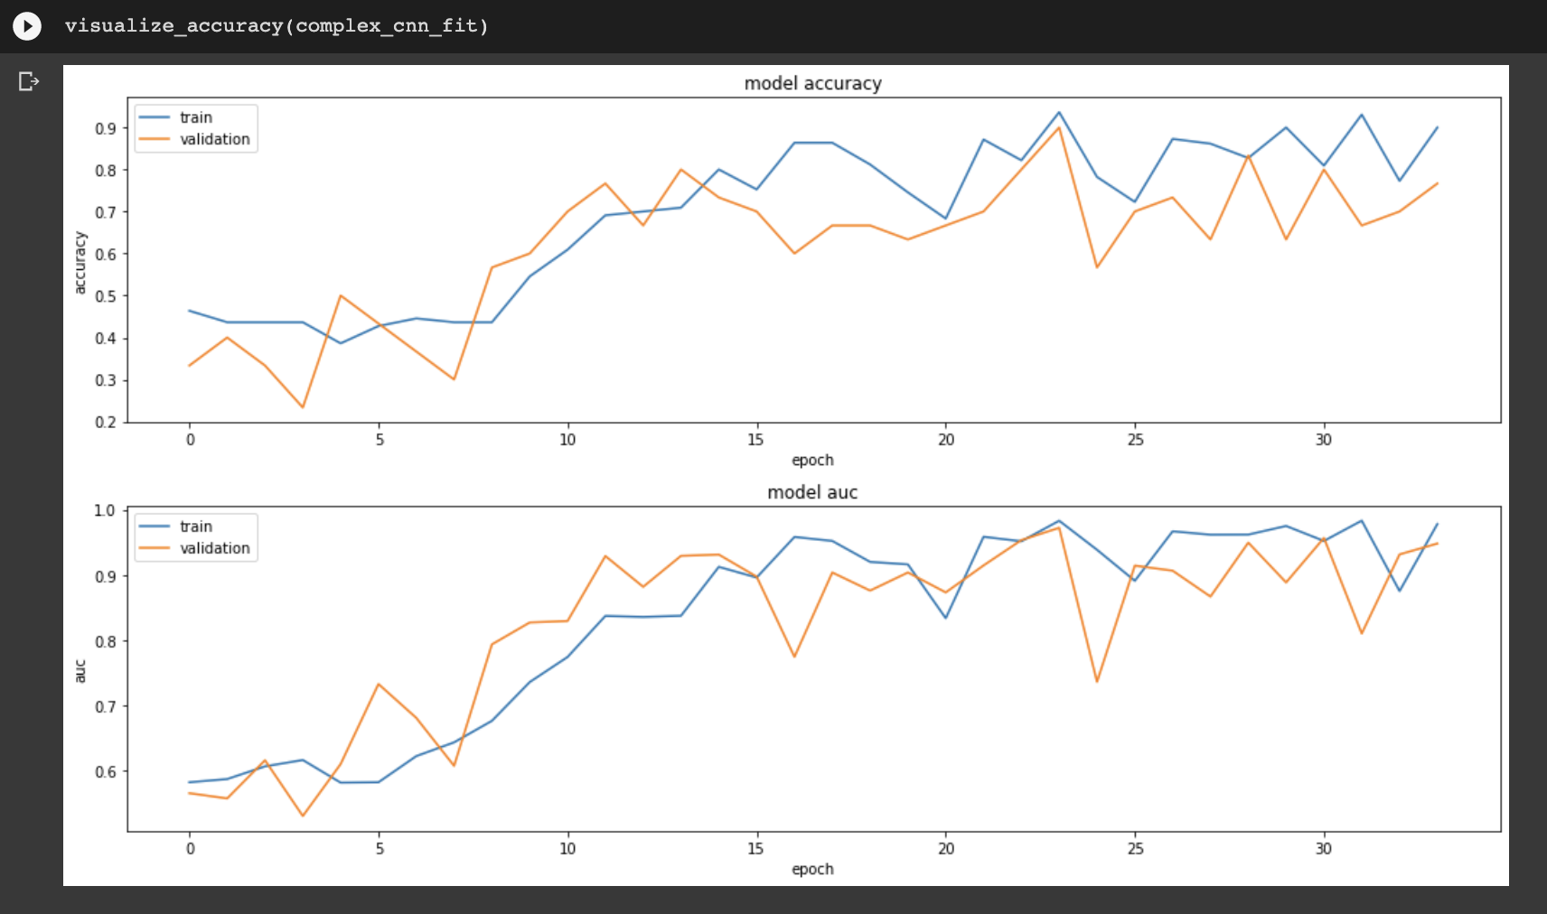
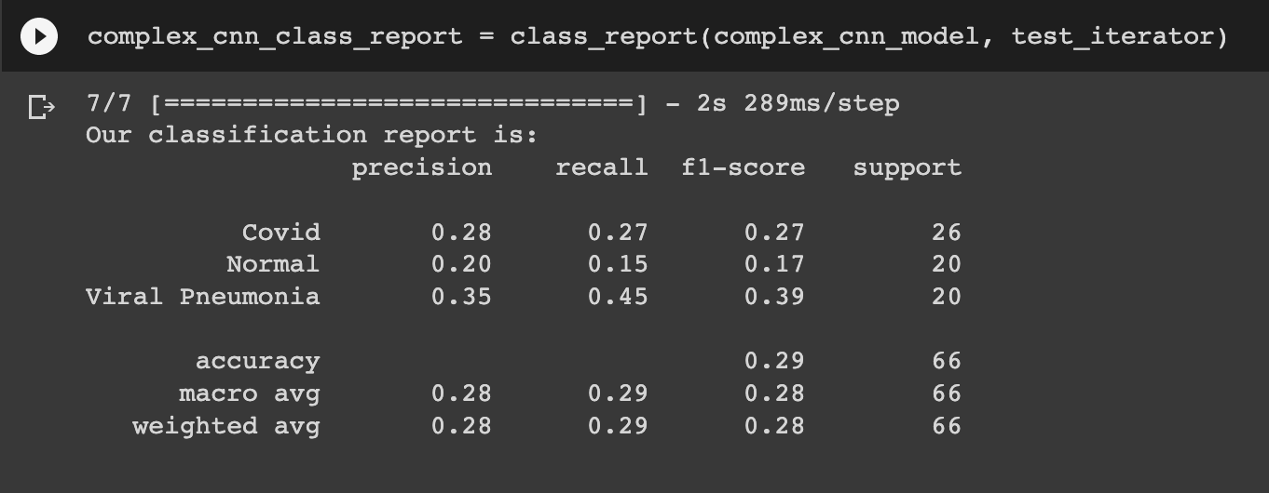
Complex CNN Results

Slide 11
Quick Segue to Pretrained Models and research

Slide 12
Research Done on COVID-19 Deep Learning
https://www.sciencedirect.com/science/article/pii/S0010482521001426
https://www.hindawi.com/journals/mpe/2021/3281135/
Many papers on classification of COVID-19 vs Pneumonia as this was a popular topic during the pandemic
Many papers I looked at were very similar in their approach and were successful in almost identical ways
*citations in appendix

Slide 13
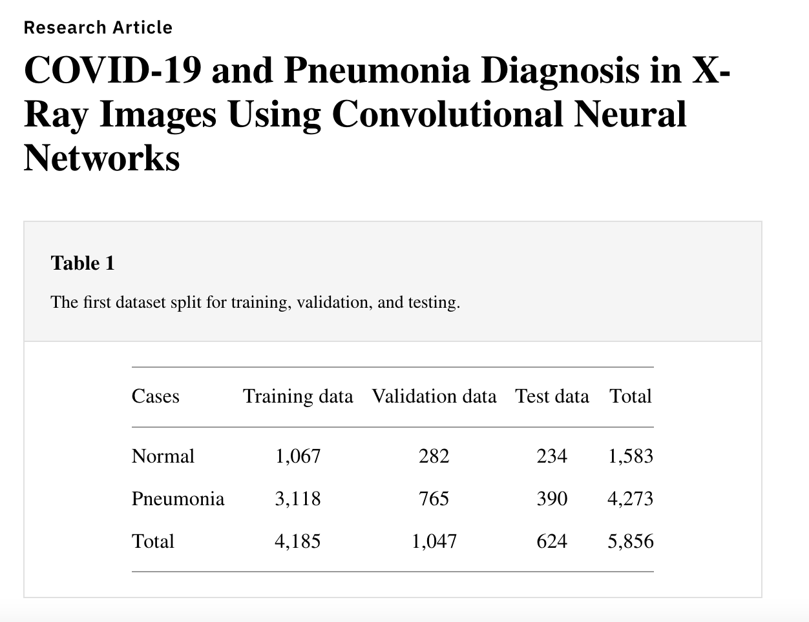
All had much bigger amount of data

Slide 14
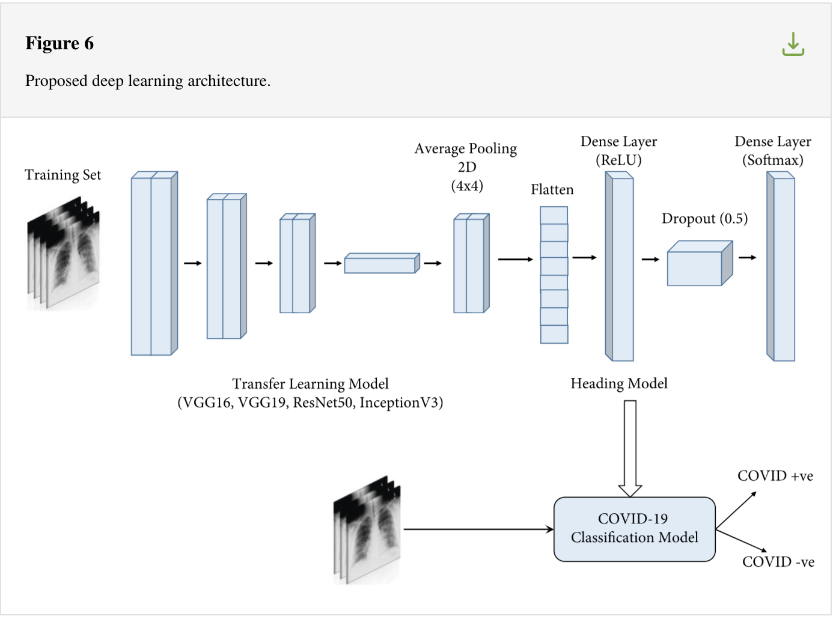
Almost all used pre-trained models and added additional problem-specific layers

Slide 15
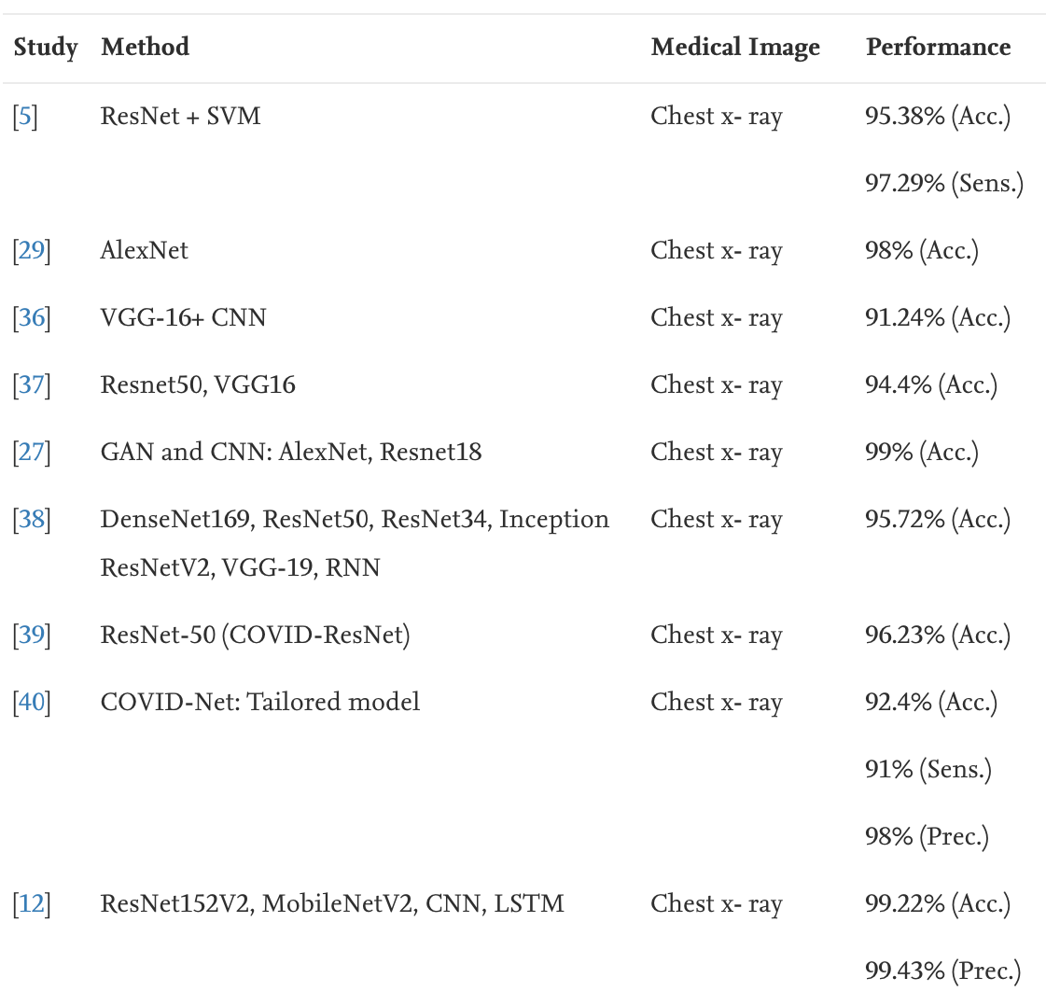
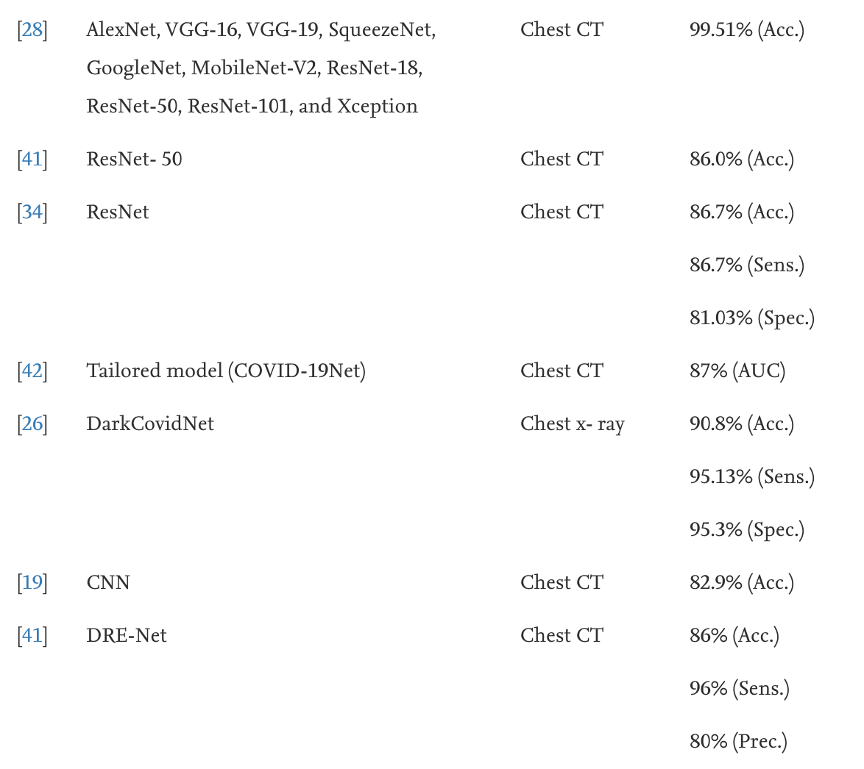
The Pre-trained Models All Have Good Results

Slide 16
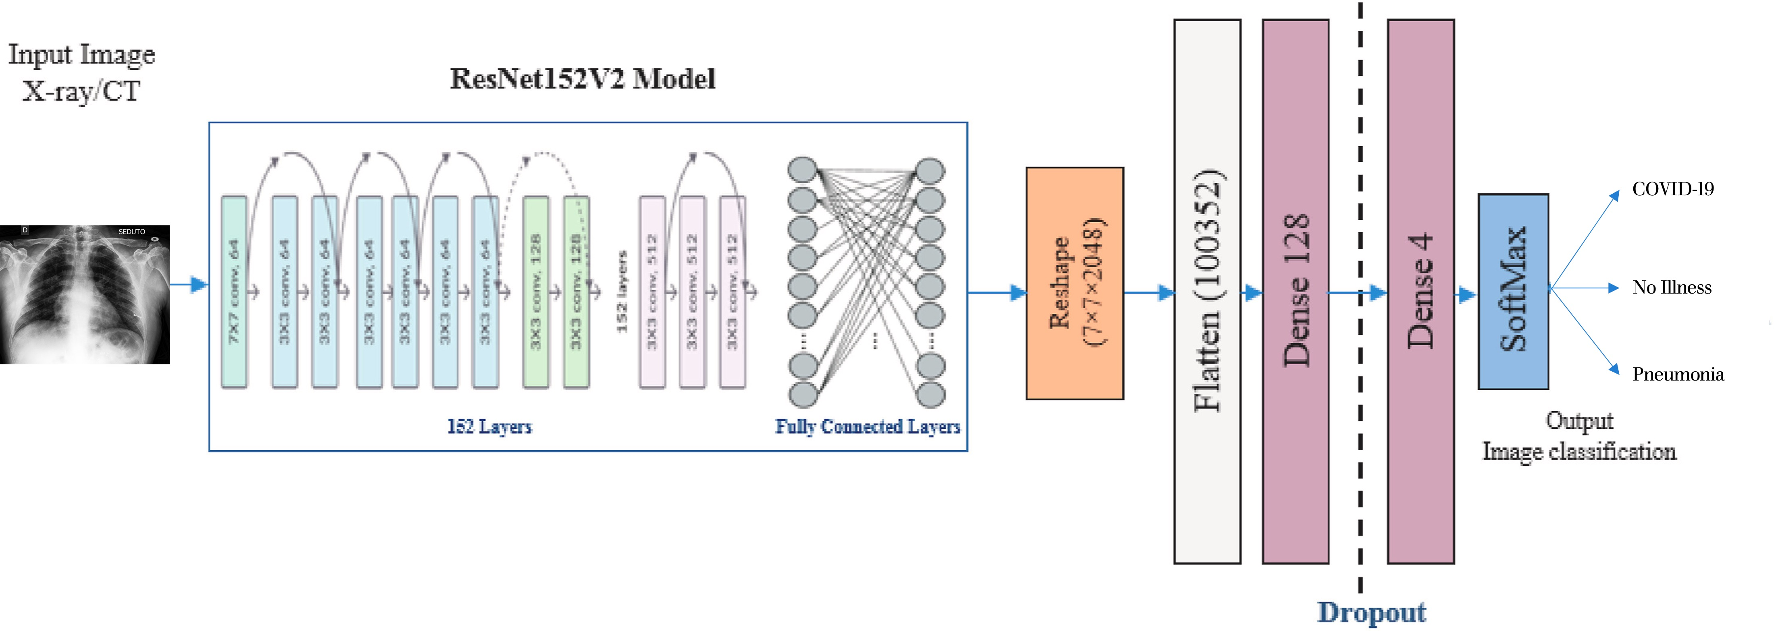
ResNet50 – 50 Layers Total Parameters – 35,000,000+
ResNet50 Model
50 Layers

Slide 17
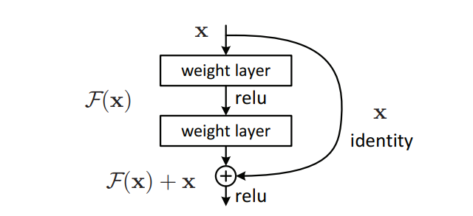
The advantage of ResNet
Skip Connections
If any layer hurt the performance of the ResNet architecture, then it will be skipped by regularization

Slide 18
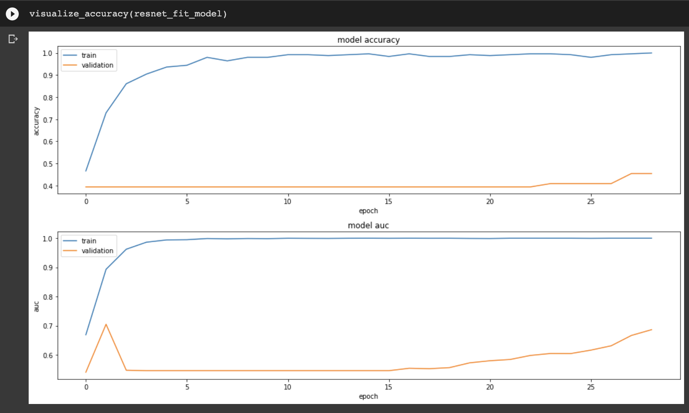
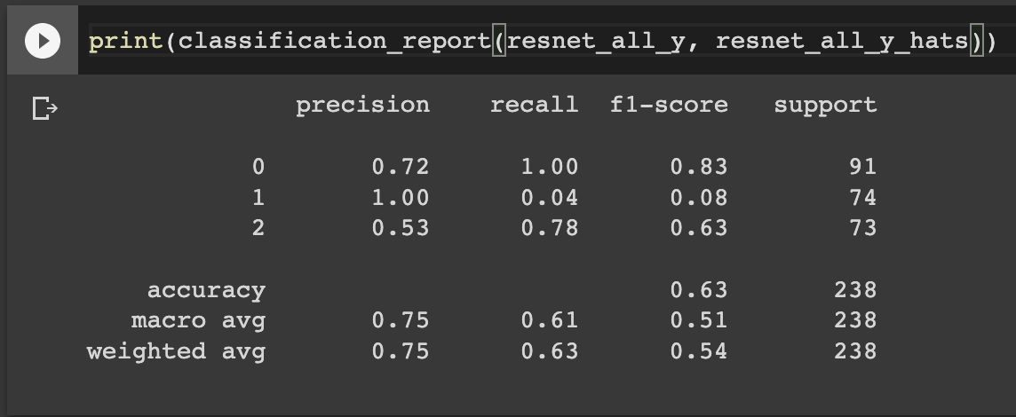
So what happened when I did the same on my small dataset?

Slide 19
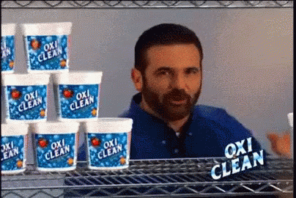

Slide 20
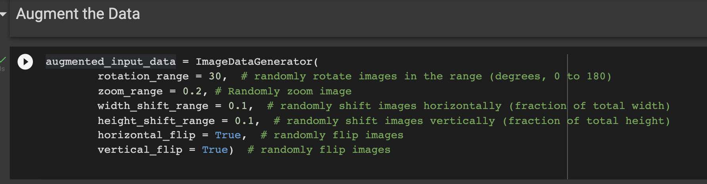
Model Tuning - Data Augmentation
There are several ways to tune a model:
Hyperparameter Tuning
Adding/Subtracting Conv2D Layers
Normalization and Data Augmentation
Data Augmentation is training a model on the same images you trained on, except altering the image (rotating, shifting, flipping), so that the model learns different angles and rotations and not the same exact angle and pixel location
Often used in Medicine where there is lack of data/images due to Privacy concerns

Slide 21
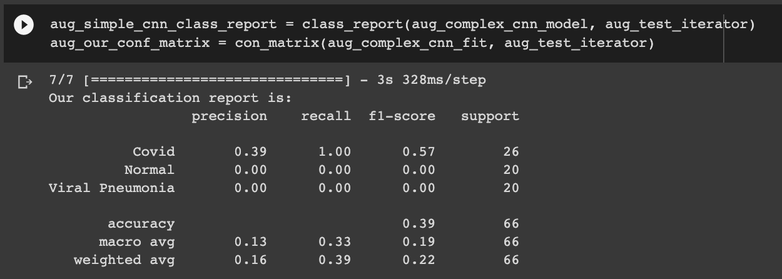
Data Augmented Complex CNN Results

Slide 22
Overall Results
Simple CNN --- 50% F-1 Score, 70% accuracy
Complex CNN --- 29% F-1 Score, 70% accuracy
DataAugmented Complex CNN --- 39% F-1 Score, 70% accuracy
ResNet50 – 63% F-1 Score, 90% accuracy
Main takeaway –
DO NOT use my model to predict if you have COVID or not…

Slide 23
Ways to Improve Results
Tune Hyperparameters
Learning Rate, Batch Size, Epochs, Pool Size, Stride Size
Tune Model Layer
Optimize Conv2D and Pooling layers, adjust strides, kernels and filters
Get more Data
Get more images than just 200 total images to train…

Slide 24

Questions?

Slide 25
Appendix/Citations
Mainuzzaman Mahin, Sajid Tonmoy, Rufaed Islam, Tahia Tazin, Mohammad Monirujjaman Khan, Sami Bourouis, "Classification of COVID-19 and Pneumonia Using Deep Transfer Learning", Journal of Healthcare Engineering, vol. 2021, Article ID 3514821, 11 pages, 2021. https://doi.org/10.1155/2021/3514821
Dina M. Ibrahim, Nada M. Elshennawy, Aamany M. Sarhan, “Deep-chest: Multi-classification deep learning model for diagnosing COVID-19, pneumonia and lung cancer chest diseases”, Computers in Biology and Medicine, Volume 132, 2021. https://doi.org/10.1016/j.compbiomed.2021.10438
Vijay Kumar, Anis Zarrad, Rahul Gupta, Omar Cheikhrouhou, "COV-DLS: Prediction of COVID-19 from X-Rays Using Enhanced Deep Transfer Learning Techniques", Journal of Healthcare Engineering, vol. 2022, Article ID 6216273, 13 pages, 2022. https://doi.org/10.1155/2022/6216273

